Slide 1
Stroke Data Analysis - Group Assignment
Group 14
1. Bethuel Maruru Kiambuthi - Team Lead
2.Faith Kagwiria Mwenda
3. Rosaline Wangari Mungai
4. Mualuko Janet Mumo
5.Japhet Kibet Cheboiywo
6.Edwin Mutendwa

Slide 2
Data Cleaning Steps
Data inspection
Checking for missing values
Checking for outliers
Checking for duplicate values

Slide 3
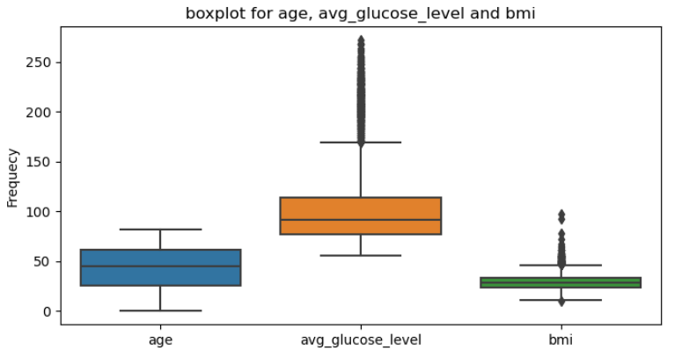
Data Inspection
Missing data for BMI 201 out of 5110 - 3.9335%
Outliers were evident on the avg_glucose, age and bmi column and the bmi as per the below boxplot

Slide 4
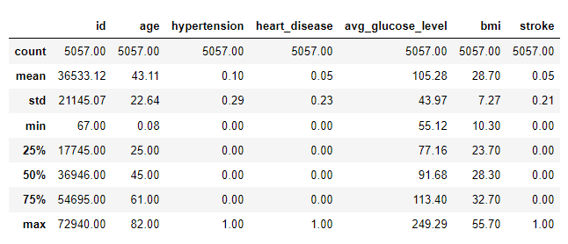
Exploratory Data Analysis (EDA) (descriptive analysis)

Slide 5
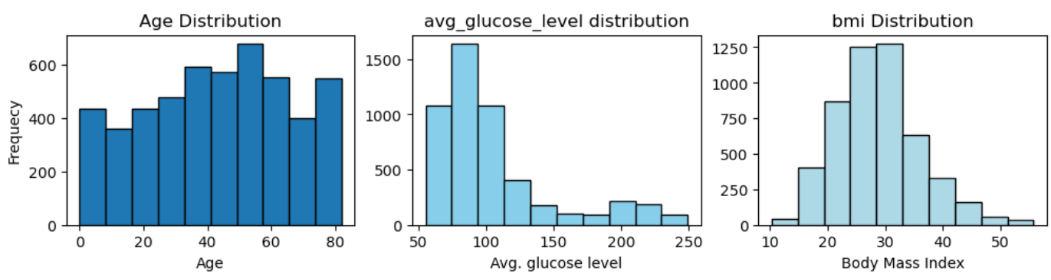
Distribution of age, avg_glucose_level, and bmi

Slide 6
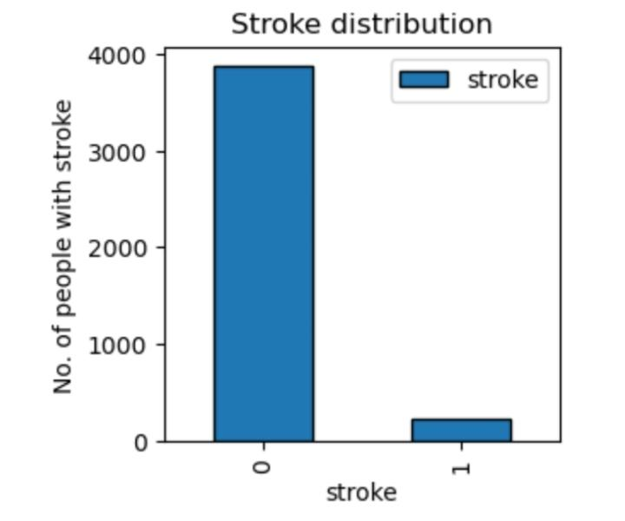
Visualizing the distribution of strokes in the dataset.
Smoking -Status | TOTAL(Stroke)
formerly smoked | 70
never smoked | 90
smokes | 42
Unknown | 47
Grand Total | 249

Slide 7
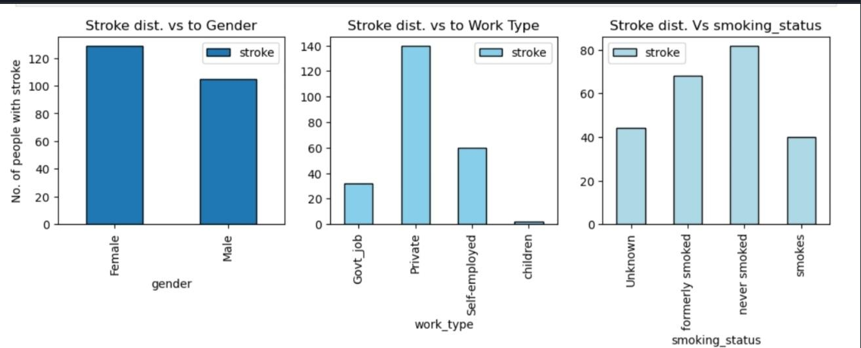
Analyzing the distribution of gender, work_type, and smoking_status with respect to strokes

Slide 8
ANALYSIS ON MARITAL STATUS & GENDER VS STROKE,HEART DISEASE AND HYPERTENSION
Marital Status | TOTAL(Heart Disease)
No | 32
Yes | 244
Grand Total | 276
Marital Status | TOTAL(Hypertension)
No | 53
Yes | 445
Grand Total | 498
Marital Status | TOTAL(Stroke)
No | 29
Yes | 220
Grand Total | 249
Gender | TOTAL(Heart Disease)
Female | 113
Male | 163
Grand Total | 276
Gender | TOTAL(Hypertension)
Female | 276
Male | 222
Grand Total | 498
Gender | TOTAL(Stroke)
Female | 141
Male | 108
Grand Total | 249
Married people have the highest numbers in-terms of heart Disease,hypertension and stroke.This can be attributed to the stress levels experienced in marriage .
Females have high numbers in Hypertension and stroke and males are leading in Heart Disease.

Slide 9
ANALYSIS ON WORKTYPE VS STROKE,HYPERTENSION AND HEART DISEASE
Work-Type | Total(Heart Disease)
children | 1
Govt_job | 36
Never_worked | 0
Private | 158
Self-employed | 81
Grand Total | 276
Work-Type | Total(Hypertension)
children | 0
Govt_job | 73
Never_worked | 0
Private | 281
Self-employed | 144
Grand Total | 498
Work-Type | Total(Stroke)
children | 2
Govt_job | 33
Never_worked | 0
Private | 149
Self-employed | 65
Grand Total | 249
People who work in the private sector have the highest numbers in heart disease,Hypertension and Stroke .This can be contributed to working ethics ,stress levels,personal initiatives to keep fit and healthy by this group.
People who have never worked before have n heart disease,stroke or hypertension.Children also on this group have no disease.

Slide 10
ANALYSIS ON RESIDENCY VS STROKE ,HYPERTENSION AND HEART DISEASE
Residency | TOTAL(Stroke)
Rural | 114
Urban | 135
Grand Total | 249
Residency | TOTAL(Heart Disease)
Rural | 134
Urban | 142
Grand Total | 276
Residency | TOTAL(Hypertension)
Rural | 251
Urban | 247
Grand Total | 498
People in the urban areas have high numbers of stroke patients .This can be as a result of the lifestyle conditions and eating habits in the urban area.
Urban areas also have more people with heart disease than rural.
Rural has more hypertensive cases than urban though with a small margin in difference compared to urban.

Slide 11
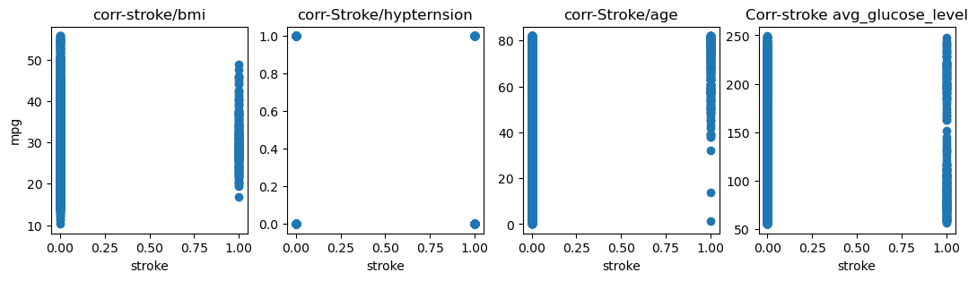
Correlation graphs.

Slide 12
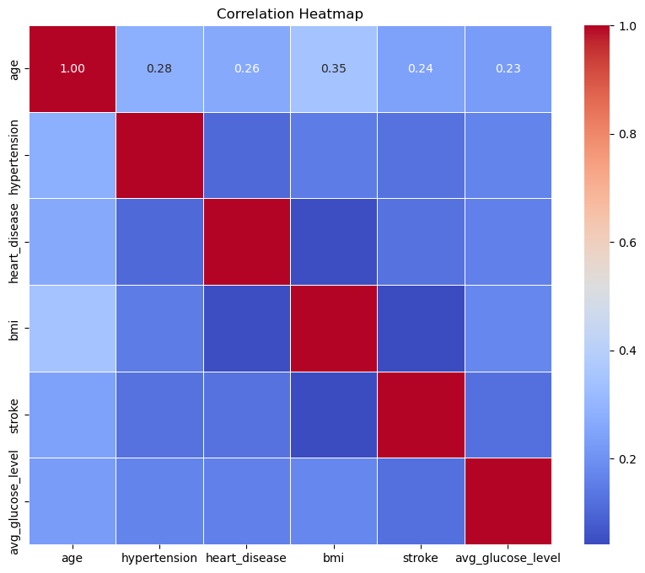
Correlation Heatmap

Slide 13
Correlation Summary
 | age | hypertension | heart_disease | bmi | stroke | avg_glucose_level
age | 1.000 | 0.278 | 0.263 | 0.348 | 0.244 | 0.228
hypertension | 0.278 | 1.000 | 0.105 | 0.149 | 0.126 | 0.167
heart_disease | 0.263 | 0.105 | 1.000 | 0.048 | 0.128 | 0.159
bmi | 0.348 | 0.149 | 0.048 | 1.000 | 0.042 | 0.174
stroke | 0.244 | 0.126 | 0.128 | 0.042 | 1.000 | 0.121
avg_glucose_level | 0.228 | 0.167 | 0.159 | 0.174 | 0.121 | 1.000

Slide 14
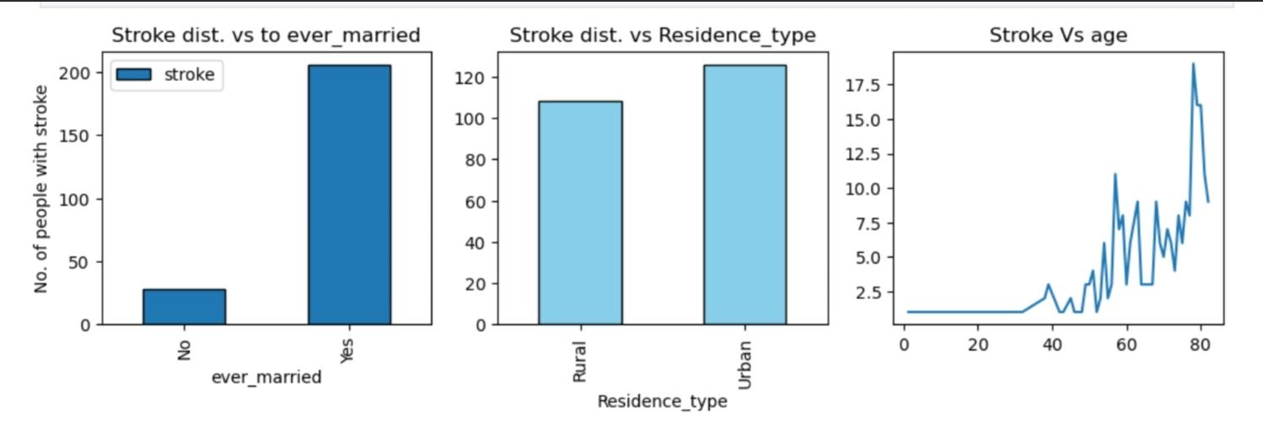
Identifying and analyzing patterns or trends that might be interesting.

Slide 15
Summary and Insights
Summarize
The correlation matrix reveals moderate positive correlations between age and BMI (0.348) as well as average glucose level and age (0.228).
Weak associations are observed between hypertension and heart disease (0.105) and BMI and stroke (0.042).
People who have ever gotten married have a higher probability of getting stroke as compared to those who haven't married.
From the data people in the urban and rural areas have an almost equal chance of getting stroke
Older people have a higher chance of getting stroke as compared to the younger ones
Recommendations
Strengthen data collection to reduce missing values
Further analysis, including regression, is needed to establish causal relationships.

